Slide 1


NBA Players Total Points in a Season Analysis
Data Science Semester 2 Project
Dhanvin Lakshmisha

Slide 2

Introduction
Three important metrics in determining a player’s skill is the total amount the points they have.
To predict this, three important metrics exist: Field Goals, Minutes Played, and Free Throws Attempted.
I am blocking by position to remove any confounding or hindering variables in my investigation.
What is my goal/investigation?
This is the link toward the dataset I used. I filtered this data set out to only have NBA players in this 2022-2023 NBA Season.

Slide 3


Choose: Creating and Interpreting a Model
𝑌 = 𝛽0 + 𝛽1(fg) + 𝛽2(ft) + 𝛽3(mp) + 𝛽4⋅guards + 𝛽5⋅forwards+𝛽4⋅centers + 𝜖

Slide 4
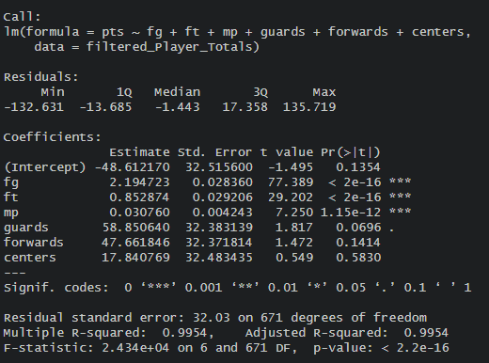
Choose: Fit
The fitted model would be :
𝑌 = -2.423616 + 2.189356(fg) + .844064(ft) + .033143(mp)
𝑌 = -42.61 + 2.19(fg) + .852(ft) + .031 (mp) + (guards) 58.8506 + (forwards)47.661+ centers (17.840769).

Slide 5
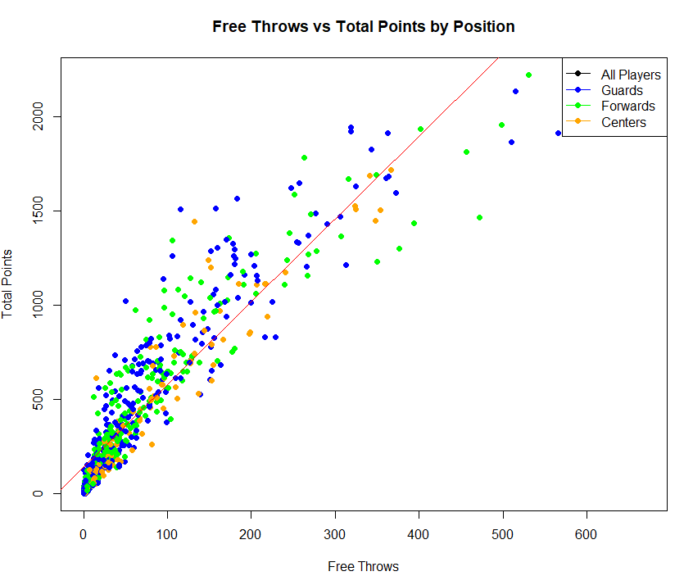
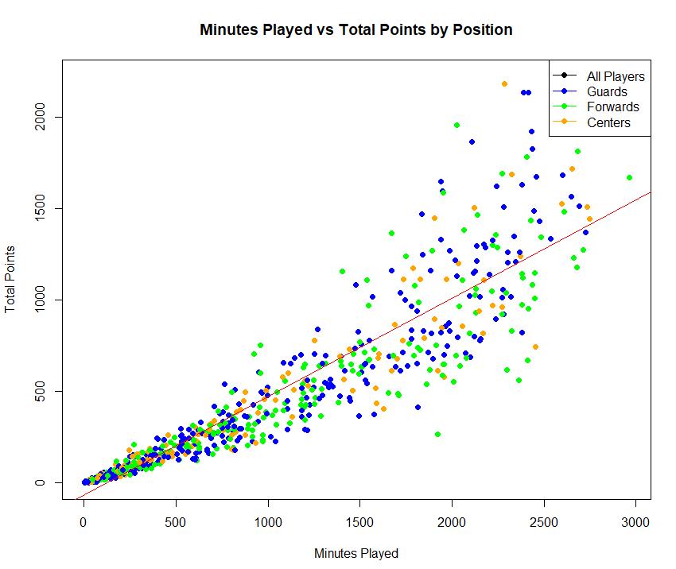
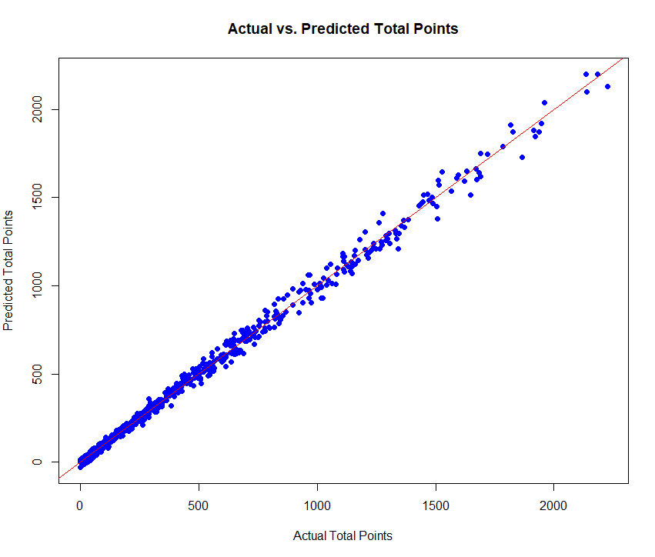
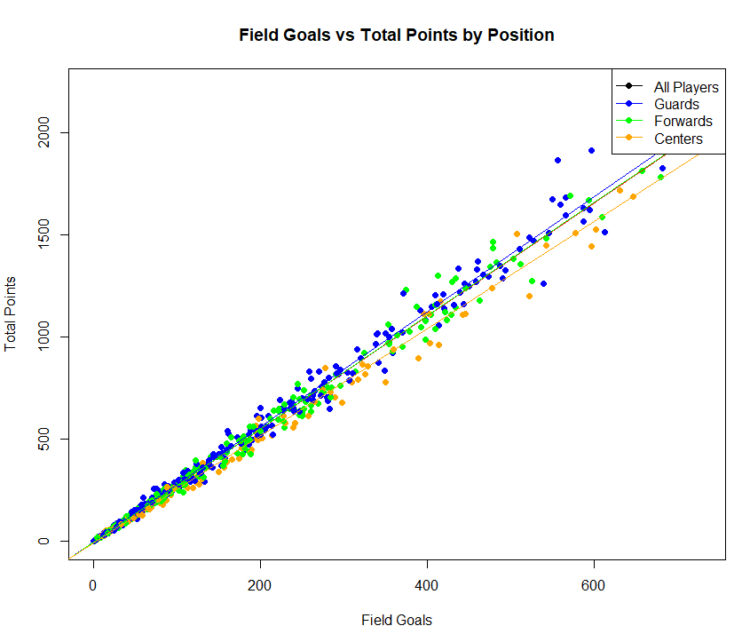
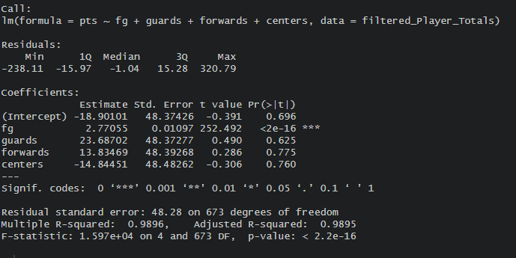
Assess:

